Slide 1
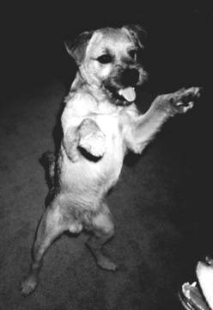
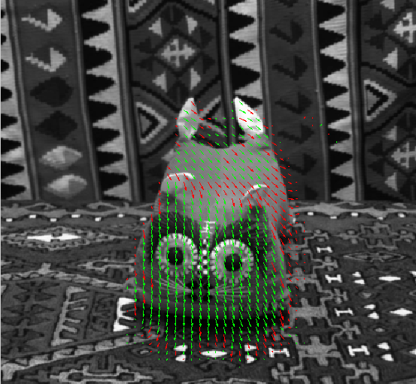
Motion Class 6
Optical Flow

Slide 2
Possible Setups
Still Camera:
Single moving object
Several moving object
Moving Camera:
Constant scene
One or more moving objects
Many cameras…

Slide 3
A Sequence of Images
Can be used for:
Segmentation
Recovering 3D shape
Ego motion recovery
Object motion:
Gesture recognition
Action recognition
Gait recognition
Tracking

Slide 4
Typical Quetions
Segmentation:
The region of each moving object
How many moving objects are there?
Object motion:
Direction in 2D/3D
Speed
Ego motion recovery
Rigidity?

Slide 5

Segmentation
Taken from http://www.cquest.utoronto.ca/psych/psy280f/ch8/rdc.html

Slide 6
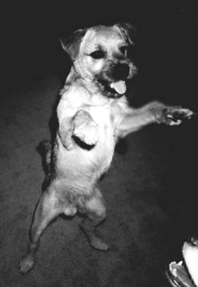
http://www.cquest.utoronto.ca/psych/psy280f/ch8/archieMove.html

Slide 8
Motion
Small movement:
Correspondence is easier
Optical flow
Ambiguity: aperture problem
Large movement (wide baseline stereo)
Correspondence is harder
“Triagulation”: more robust

Slide 9
Feature Correspondence and Perception

Slide 10
Correspondence
Perceived motion.
Which point in image I_{t} corresponds to which point in image I_{t+1}?

Slide 11
Taken from http://www-psy.ucsd.edu/~sanstis/motion.html

Slide 12
Distance
Taken from http://www-psy.ucsd.edu/~sanstis/motion.html

Slide 13
Taken from http://www-psy.ucsd.edu/~sanstis/motion.html

Slide 14
Global movement
Taken from http://www-psy.ucsd.edu/~sanstis/motion.html

Slide 15
Shape similarity
http://www.cquest.utoronto.ca/psych/psy280f/ch8/ternus.html

Slide 16
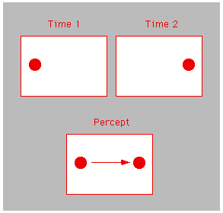
Taken from http://www.cquest.utoronto.ca/psych/psy280f/ch8/amTiming.html

Slide 17
Motion Estimation Direction
Where are the moving regions moving to?
Finding the geometric relation between two images can serve in many applications

Slide 18
Existing Approaches for Motion Estimation
Correlation based
Gradient based
Feature based
We focus here

Slide 19
Track Small Changes
Optical flow:
Assign to each pixel in one image, a motion vector, relating it to the second image

Slide 20
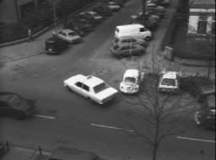
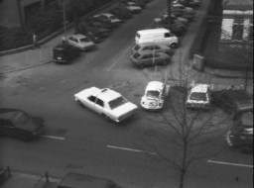
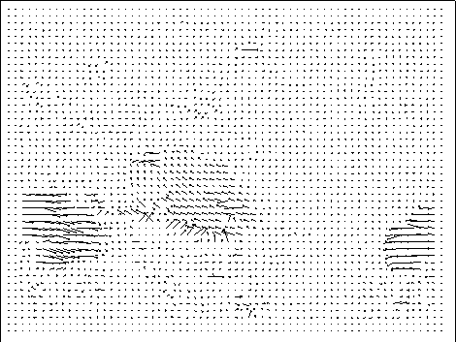
Optical Flow
For each pixel, a velocity vector (u,v)
http://extra.cmis.csiro.au/IA/changs/motion/

Slide 21
Computing Motion Vectors
Zooming out
Zooming in
Translation

Slide 23
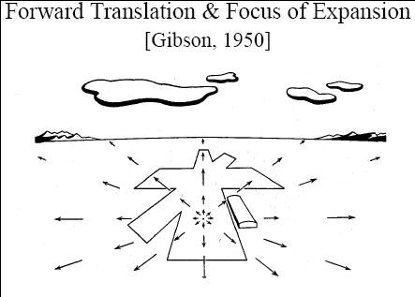

Slide 24
Aperture Problem

Slide 25
Aperture Problem

Slide 26
Aperture Problem

Slide 27
Aperture Problem

Slide 28
Barber Pole
demo

Slide 29
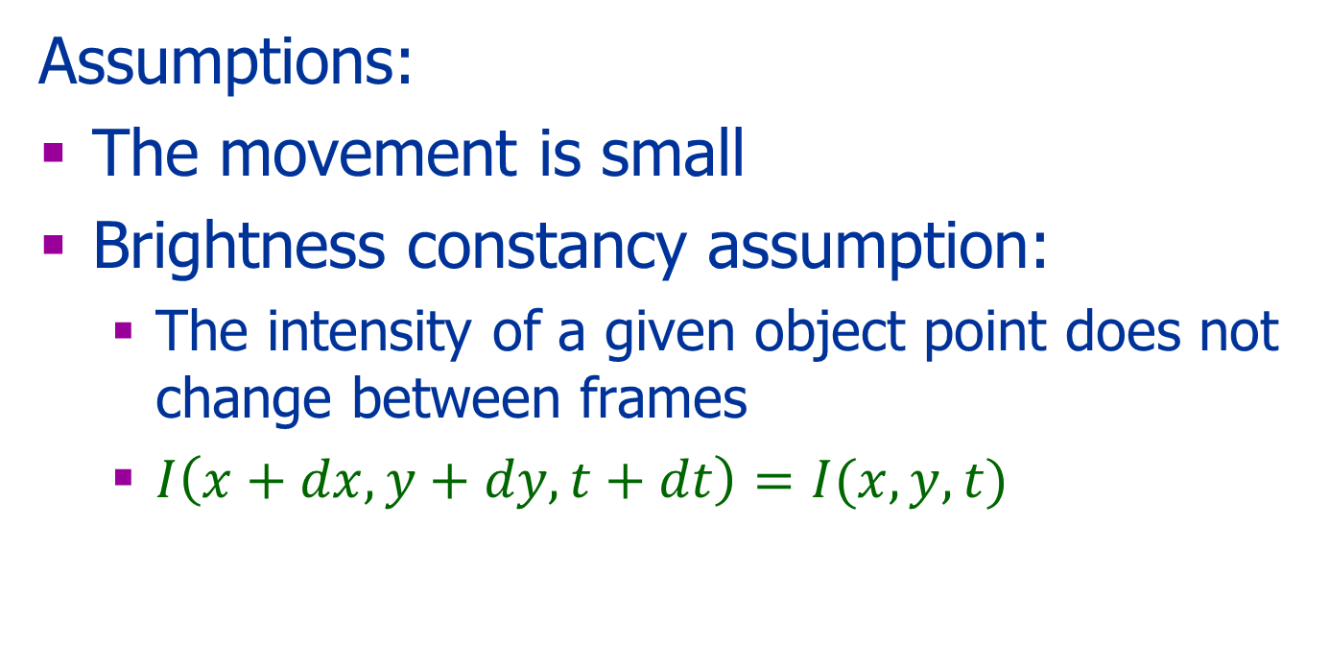
Optical Flow
Assumptions:
The movement is small
Brightness constancy assumption:
The intensity of a given object point does not change between frames
$I\left(x+dx,y+dy,t+dt\right)=I(x,y,t)$

Slide 30
Optical Flow Equation
Taylor Series:
Under the constant brightness assumption:

Slide 31
The Gradient Based Method
Using:
The Brightness Constancy Equation (BCE)
The Taylor series
Neglect high order derivatives

Slide 32
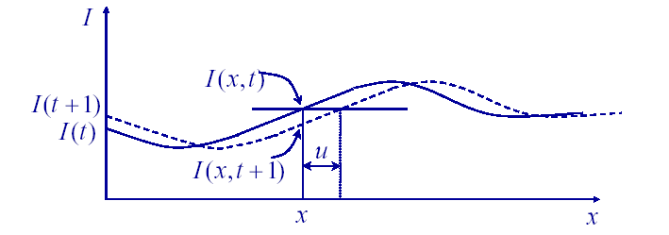
Geometric Interpretation

Slide 33
Ambiguity
*
*
*

Slide 34
The BC (Cont.)
Relates spatial and temporal gradients
Assumptions:
First order approximation:
u(x,y) and v(x,y) are small
An under-determined problem (aperture Problem):
u(x,y) and v(x,y) are smooth

Slide 35
Solution of Ambiguity
Global constraints
Local constraint: assume constant motion in a small local window

Slide 36
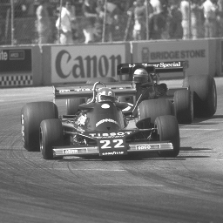
Local Smoothness Assumption
(u₁,v₁)
(u₂,v₂)
(u₃,v₃)
Perform Optical Flow Computation locally.

Slide 37
Local Constant Flow
The basic equation:
In a matrix notation:

Slide 38
Local Constant Flow
Assumption:
In a small neighborhood the motion is the same

Slide 39
Local Constant Flow
The same equations for a set of k pixels:
Is there a problem?

Slide 40
Cases
Let C=A^{T}A
rank(C) = 0 blank wall problem
rank(C) = 1 aperture problem
rank(C) = 2 enough texture – good feature candidates
C

Slide 41
The Algorithm
Smooth the image in the special domain
Smooth the image in the temporal domain
For each pixel:
Compute A and b
Compute C
If rank(C)=2, compute u and v by

Slide 42


Modification
Weighted list square:
$$A=$$
Where W is a weight matrix
In this case: $C=A^{T}WA$

Slide 43
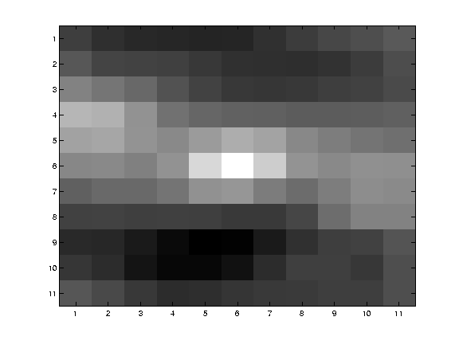
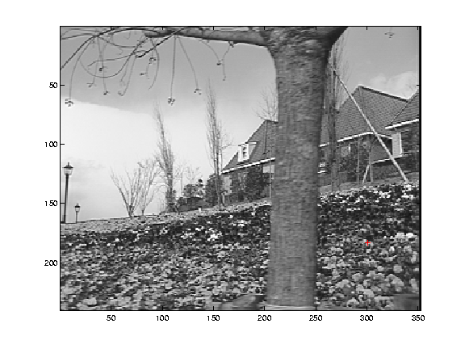
Textured area
C

Slide 44
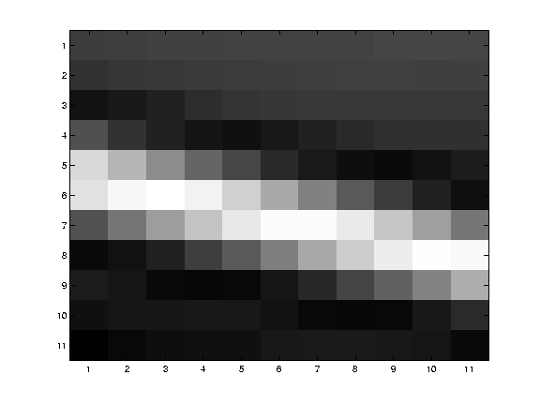
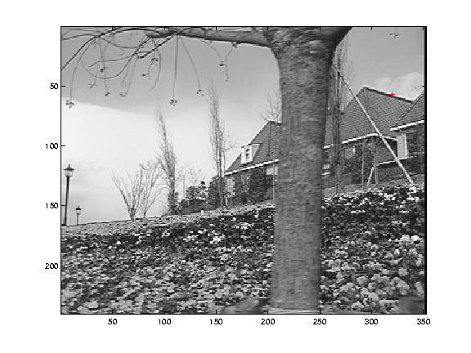
Edge
C

Slide 45
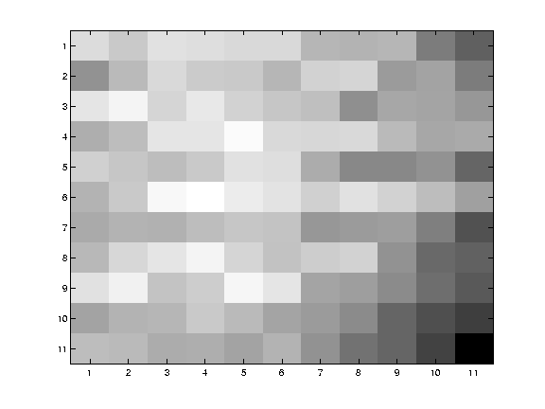
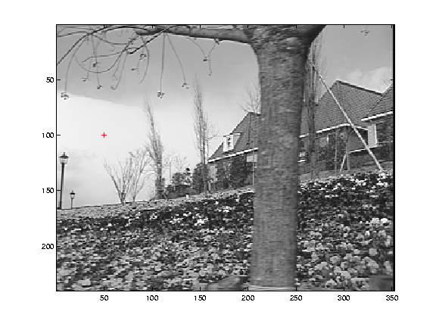
Homogeneous area
C

Slide 46

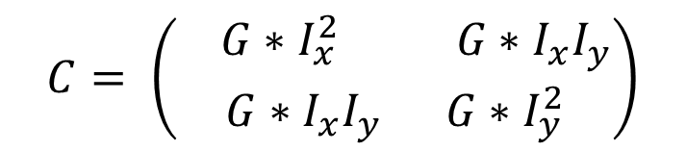
Modification
Replace $Σ$ by Convolution with Gaussian
C
$$C= \left(\begin{aligned} G∗I_{x}^{2} G∗I_{x}I_{y} \\ G∗I_{x}I_{y} G∗I_{y}^{2}\end{aligned}\right)$$

Slide 47
What can go wrong?
Brightness constancy is not satisfied
The motion is not small
A point does not move like its neighbors
window size is too large
what is the ideal window size?

Slide 48
Reduce the Resolution
Taken from Dyer

Slide 49
Large Movement
u=1.25 pixels
u=2.5 pixels
u=5 pixels
image J
u=10 pixels
image J
image I
image I
Pyramid of image J
Pyramid of image I

Slide 51
More Tools
Combine information along the sequence
Use assumptions on the motion
Use assumptions on the structure
How?
Local methods
Global methods

Slide 52
More Motion Models
2D Models:
Translation
Rotation
Euclidean
Similarity
Affine
Planar projective transform (Homography)

Slide 53
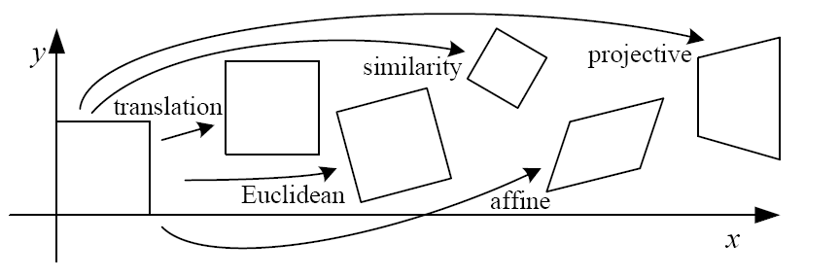
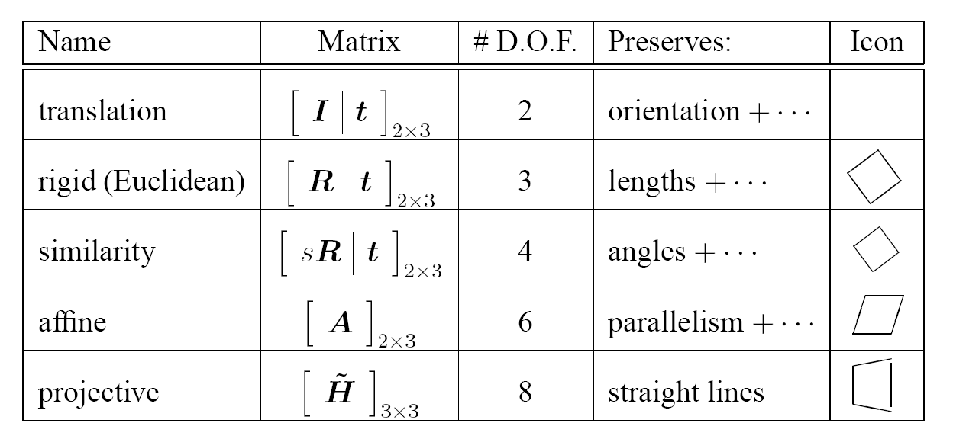
2D image transformations
These transformations are closed under composition and inverse is a member
Taken from: http://graphics.cs.cmu.edu/courses/15-463/2006_fall/www/Lectures/direct-alignment.pdf

Slide 54
Example: Affine Motion
Least Square Minimization: search for a_{i}

Slide 55
Results: affine motion segmentation

Slide 56
Results

Slide 57
Results

Slide 58
More results

Slide 59
Global Solutions
Knowledge about the scene
For example: smooth, piecewise smooth, planar …
Knowledge about the motion
For example: rigid, piecewise rigid, smooth, piecewise smooth…
Use global optimization

Slide 60
Example: Global Solutions
Minimize the functional:
Solve u(x,y) and v(x,y) using any optimization method (not in this course)
Brightness Constancy assumption
Smoothness of
the optical flow

Slide 61
Possible Applications
Segmentation
Object tracking
3D shape reconstruction
Align images (mosaics)
MPEG compression
Super-resolution
Correct for camera jitter (stabilization)
Many more...

Slide 62
Summary
Some psychophysics
Optical flow:
Aperture problem
Lucas Kanade algorithm
Next:
Change detection
Tracking

